Slide 1
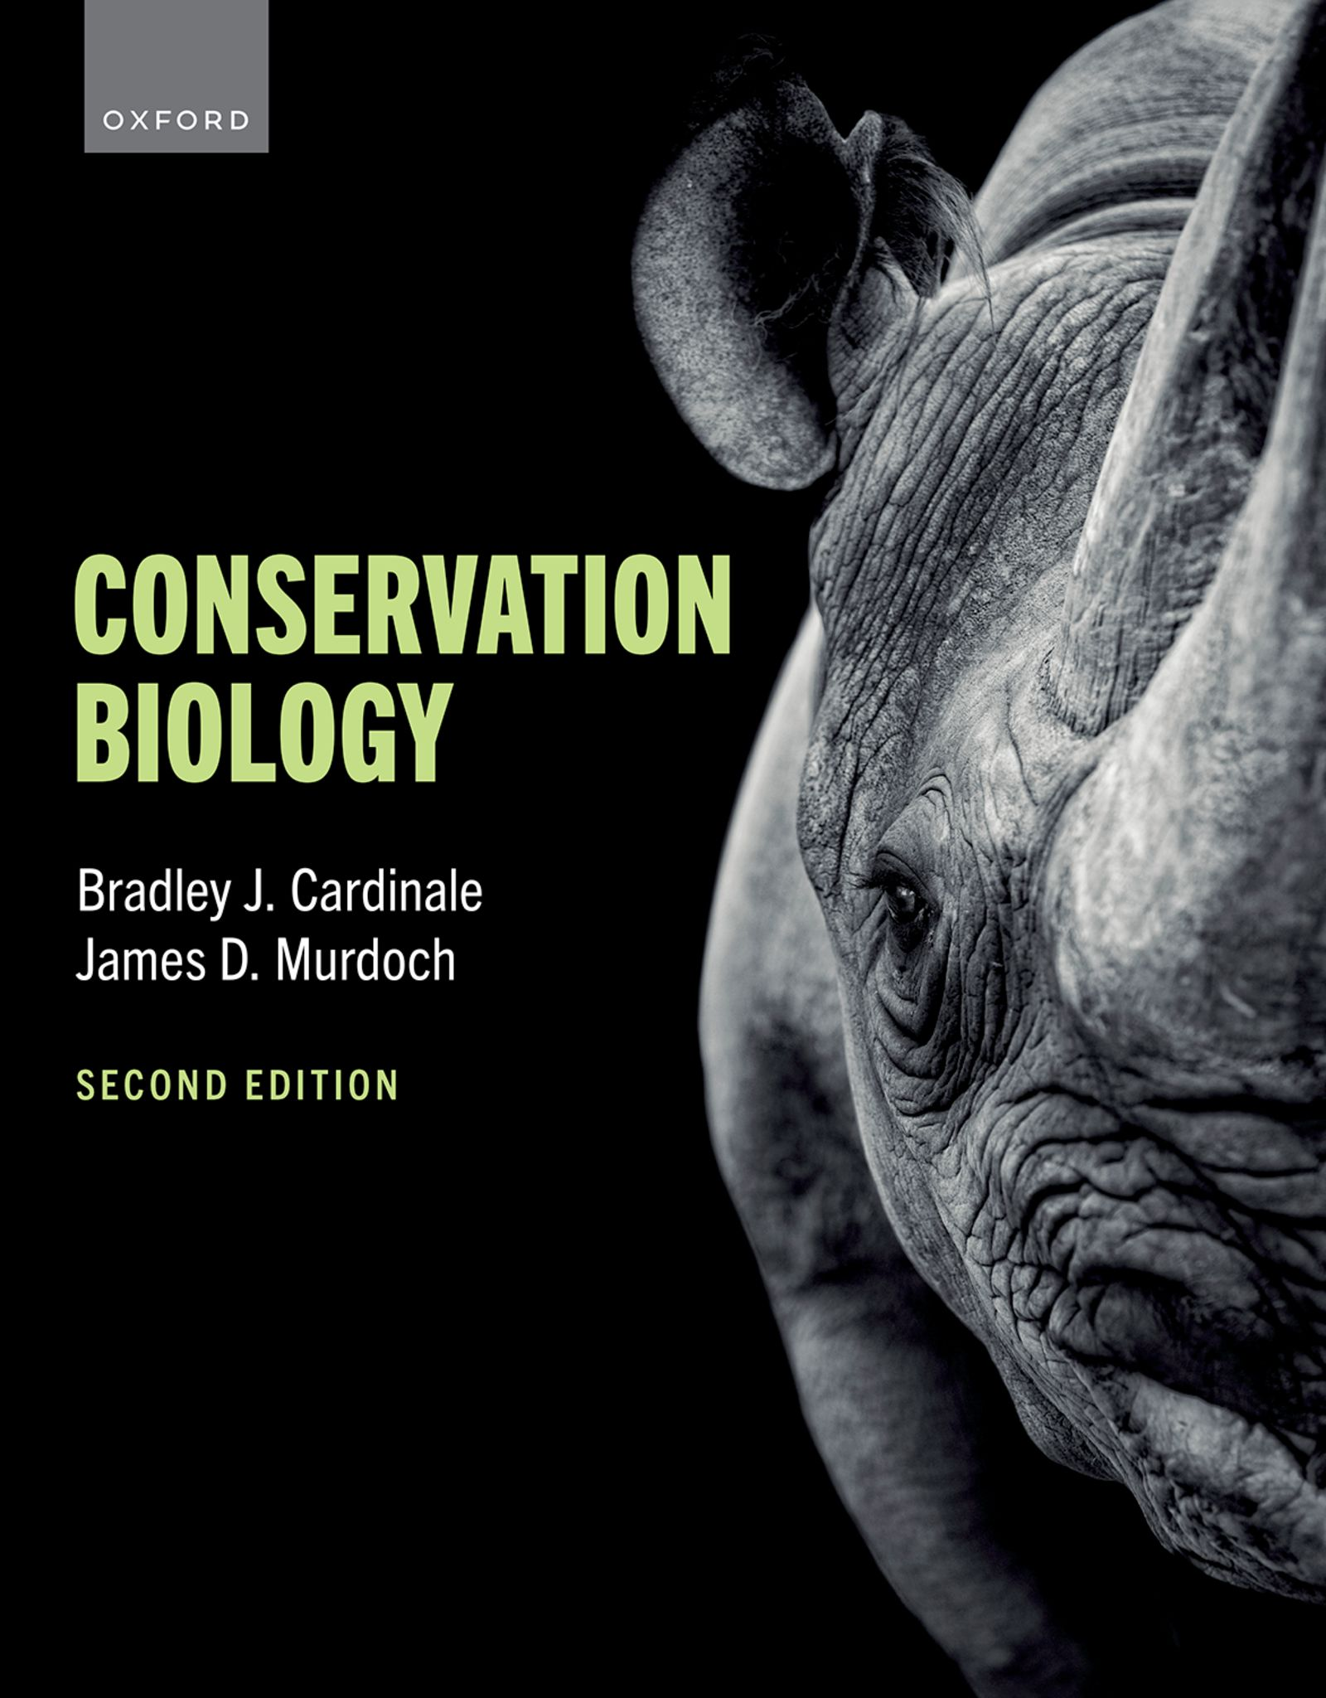
CONSERVATION BIOLOGY
By Bradley J. Cardinale and James D. Murdoch

Slide 2
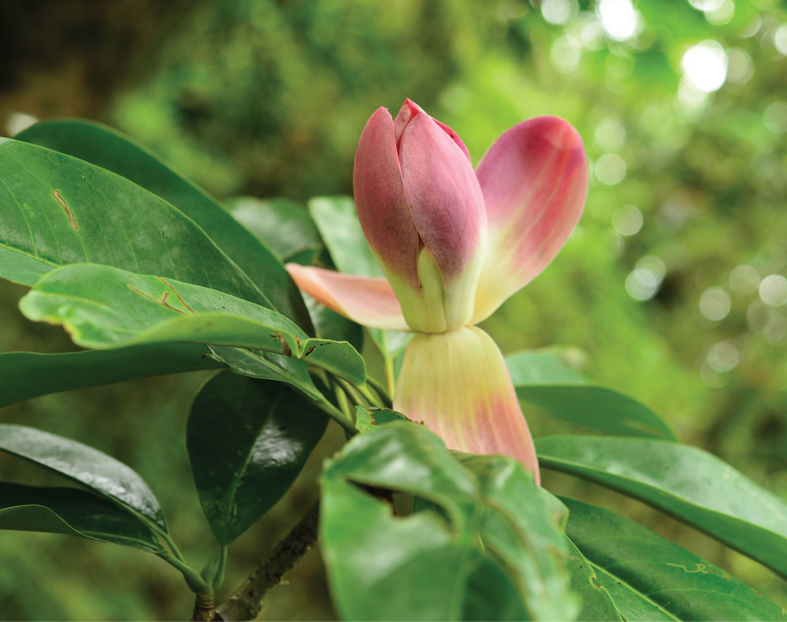
2
Notes:
Magnolia grandis, one of the most striking of the world’s wild magnolias, is native to China. Its population has declined to less than 50 individuals as a result of habitat loss caused by agricultural expansion and logging, and it is now considered Critically Endangered.

Slide 3
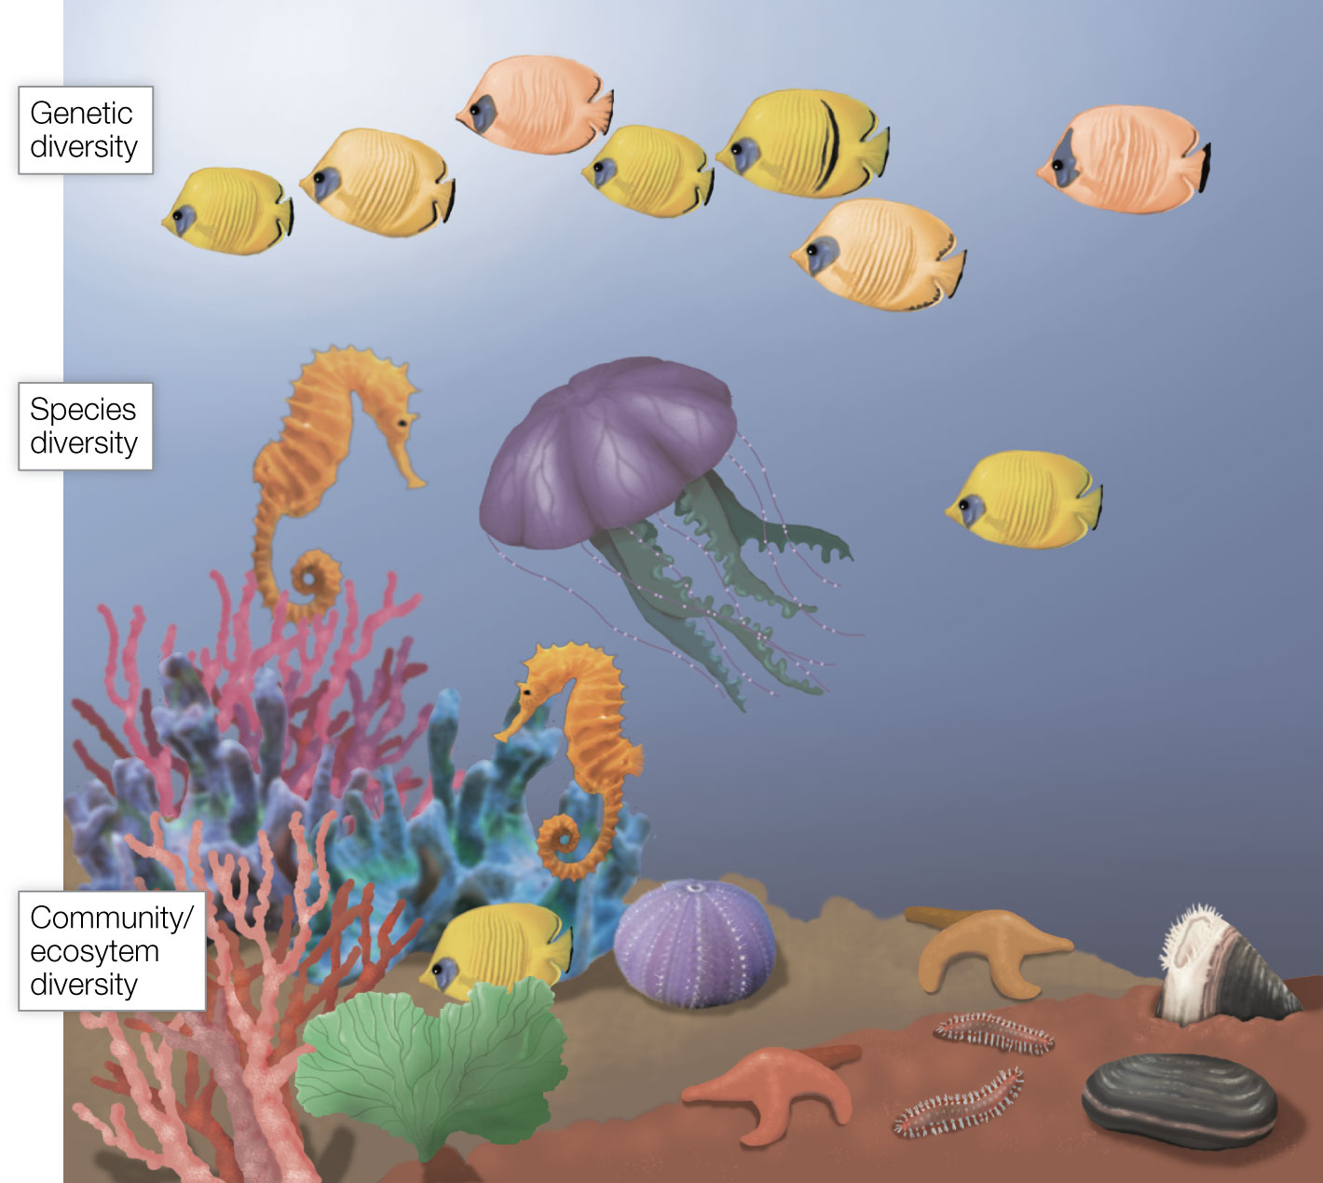
Figure 3.1 Hierarchical levels of biodiversity.
Notes:
Figure 3.1 Hierarchical levels of biodiversity. Biodiversity includes genetic diversity (the genetic variation that creates phenotypic variation within species), species diversity (the variety of species that comprise a biological community), and community and ecosystem diversity (the different biological communities and their associated ecosystems that comprise whole landscapes).

Slide 4
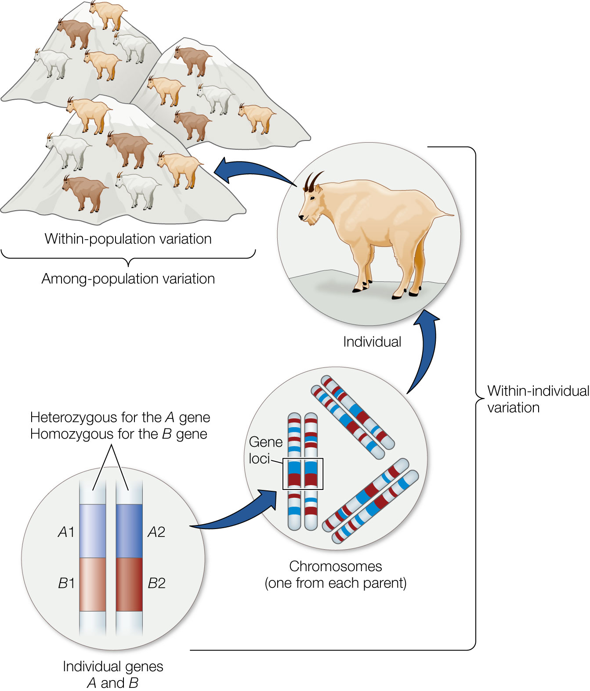
Figure 3.2 Genetic variation occurs between individuals that comprise a population of a single species.
Notes:
Figure 3.2 Genetic variation occurs between individuals that comprise a population of a single species. It is due to variation in the alleles found at particular gene loci and to variation between chromosomes. Genetic variation also occurs between spatially separated populations of the species.

Slide 5
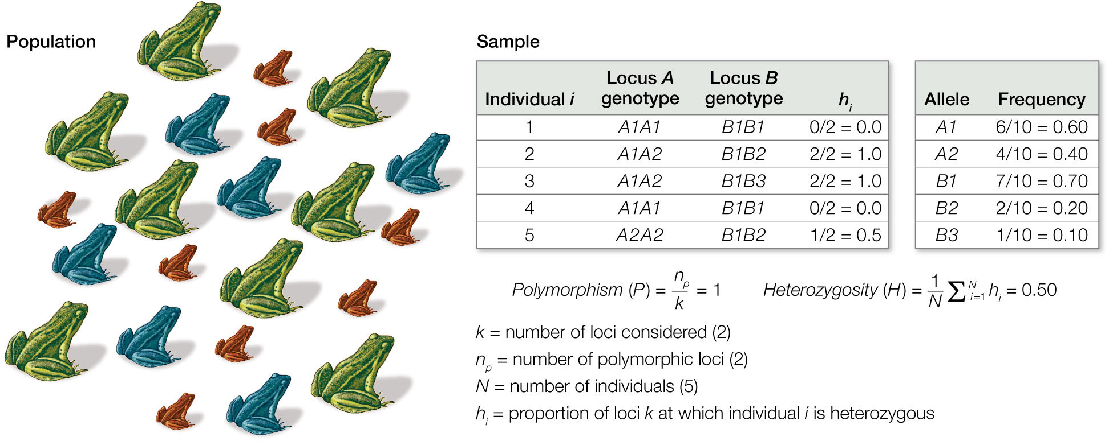
Figure 3.3 Measures of genetic diversity.
Notes:
Figure 3.3 Measures of genetic diversity. This example shows how to calculate polymorphism and heterozygosity of a hypothetical population of frogs (left). Assume that five frogs are sampled randomly such that they are representative of the larger population of frogs. Each of the five frogs is then genotyped to determine which alleles it has at each of two loci: at locus A it has either allele A1 or A2, while at locus B it has either allele B1, B2, or B3. After genotyping each frog, one can calculate the proportion of loci at which each individual is heterozygous, hi, which is then used to calculate the average heterozygosity, H, of frogs that were sampled. One can also calculate the degree of polymorphism, P, of the sampled frogs, as well as the frequency of each allele in the sampled population.

Slide 6
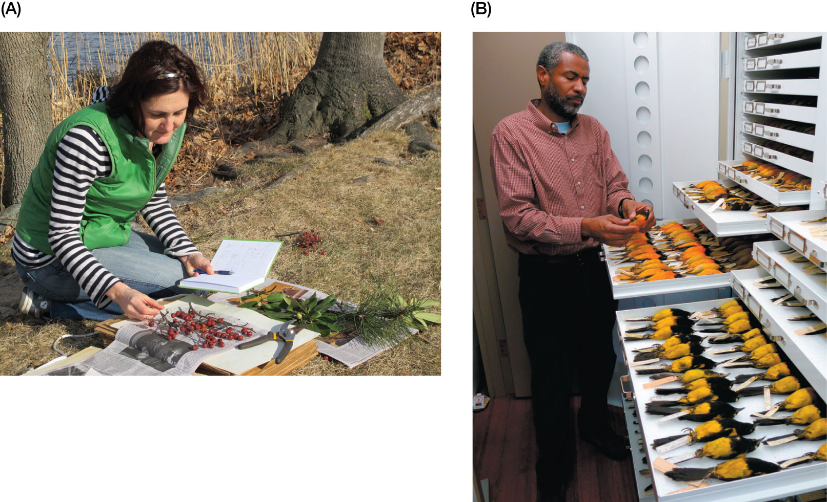
Figure 3.4 (A) A plant ecologist prepares a museum specimen using a plant press.
Notes:
Figure 3.4 (A) A plant ecologist prepares a museum specimen using a plant press. The flattened and dried plant will later be mounted on heavy paper with a label giving detailed collection information. (B) An ornithologist at the Museum of Comparative Zoology, Harvard University, classifies collections of black-cowled orioles (Icterus prosthemelas) from Mexico and Baltimore orioles (Icterus galbula) that occur throughout eastern North America

Slide 7
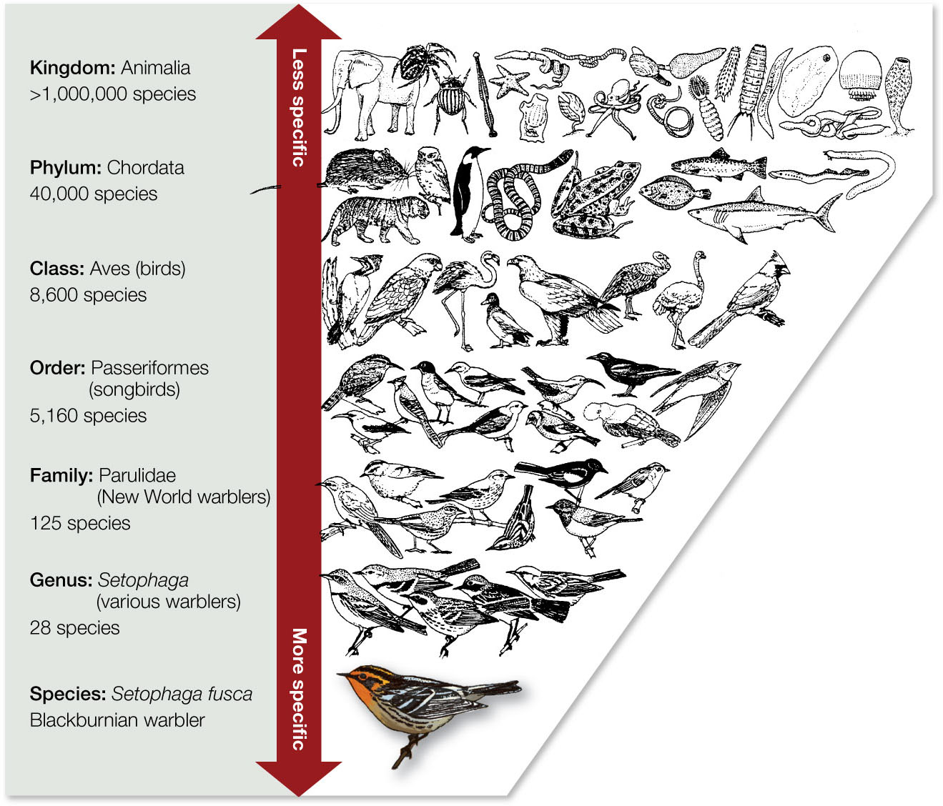
7
Notes:
Blackburnian warblers (Setophaga fusca) are related to more and more other animals at successively higher levels of taxonomic organization.

Slide 8
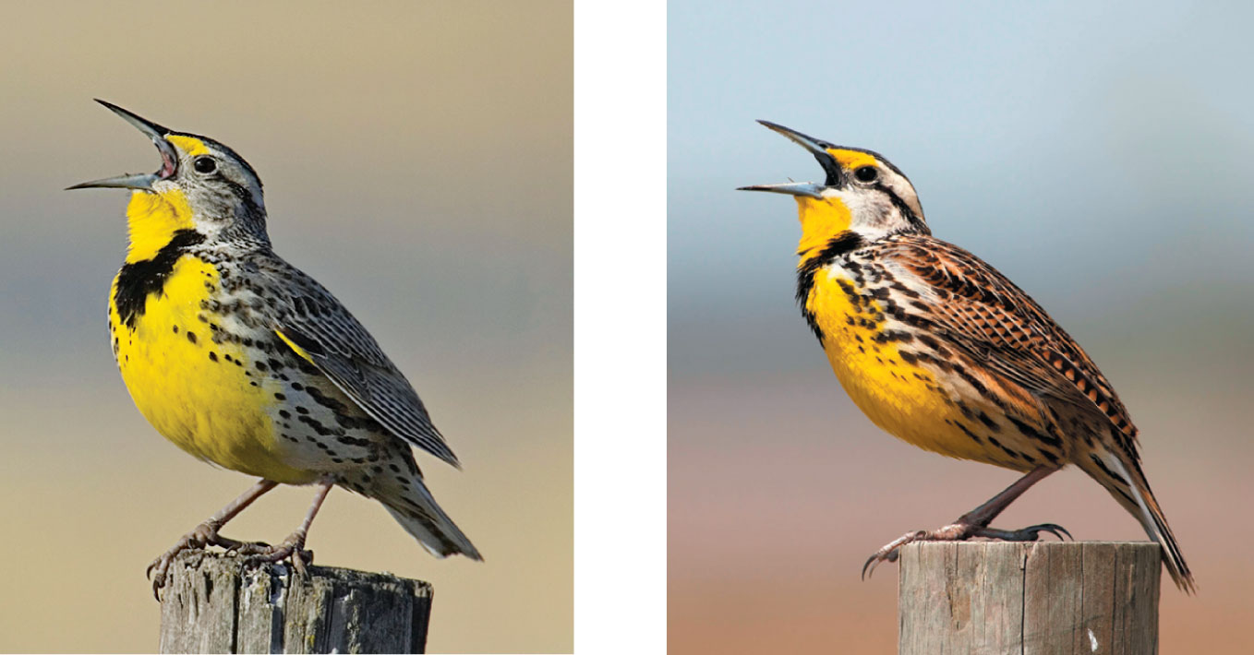
Figure 3.5 The western meadowlark (Sturnella neglecta; left) and the eastern meadowlark (Sturnella magna; right) look almost identical and sometimes even occur in the same place.
Notes:
Figure 3.5 The western meadowlark (Sturnella neglecta; left) and the eastern meadowlark (Sturnella magna; right) look almost identical and sometimes even occur in the same place. However, they are distinct species because they have different songs and do not interbreed.

Slide 9
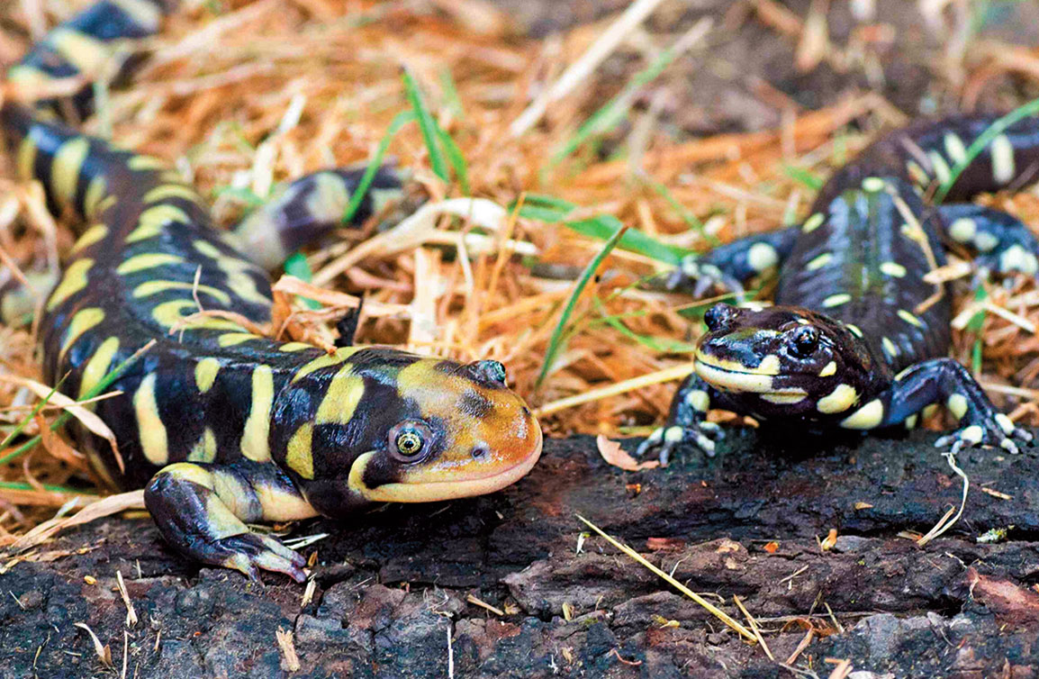
Figure 3.6 The hybrid tiger salamander (left) is larger than its parent species, the California tiger salamander (right), and is increasing in abundance. Note the much larger head of the hybrid salamander.
Notes:
Figure 3.6 The hybrid tiger salamander (left) is larger than its parent species, the California tiger salamander (right), and is increasing in abundance. Note the much larger head of the hybrid salamander.

Slide 10
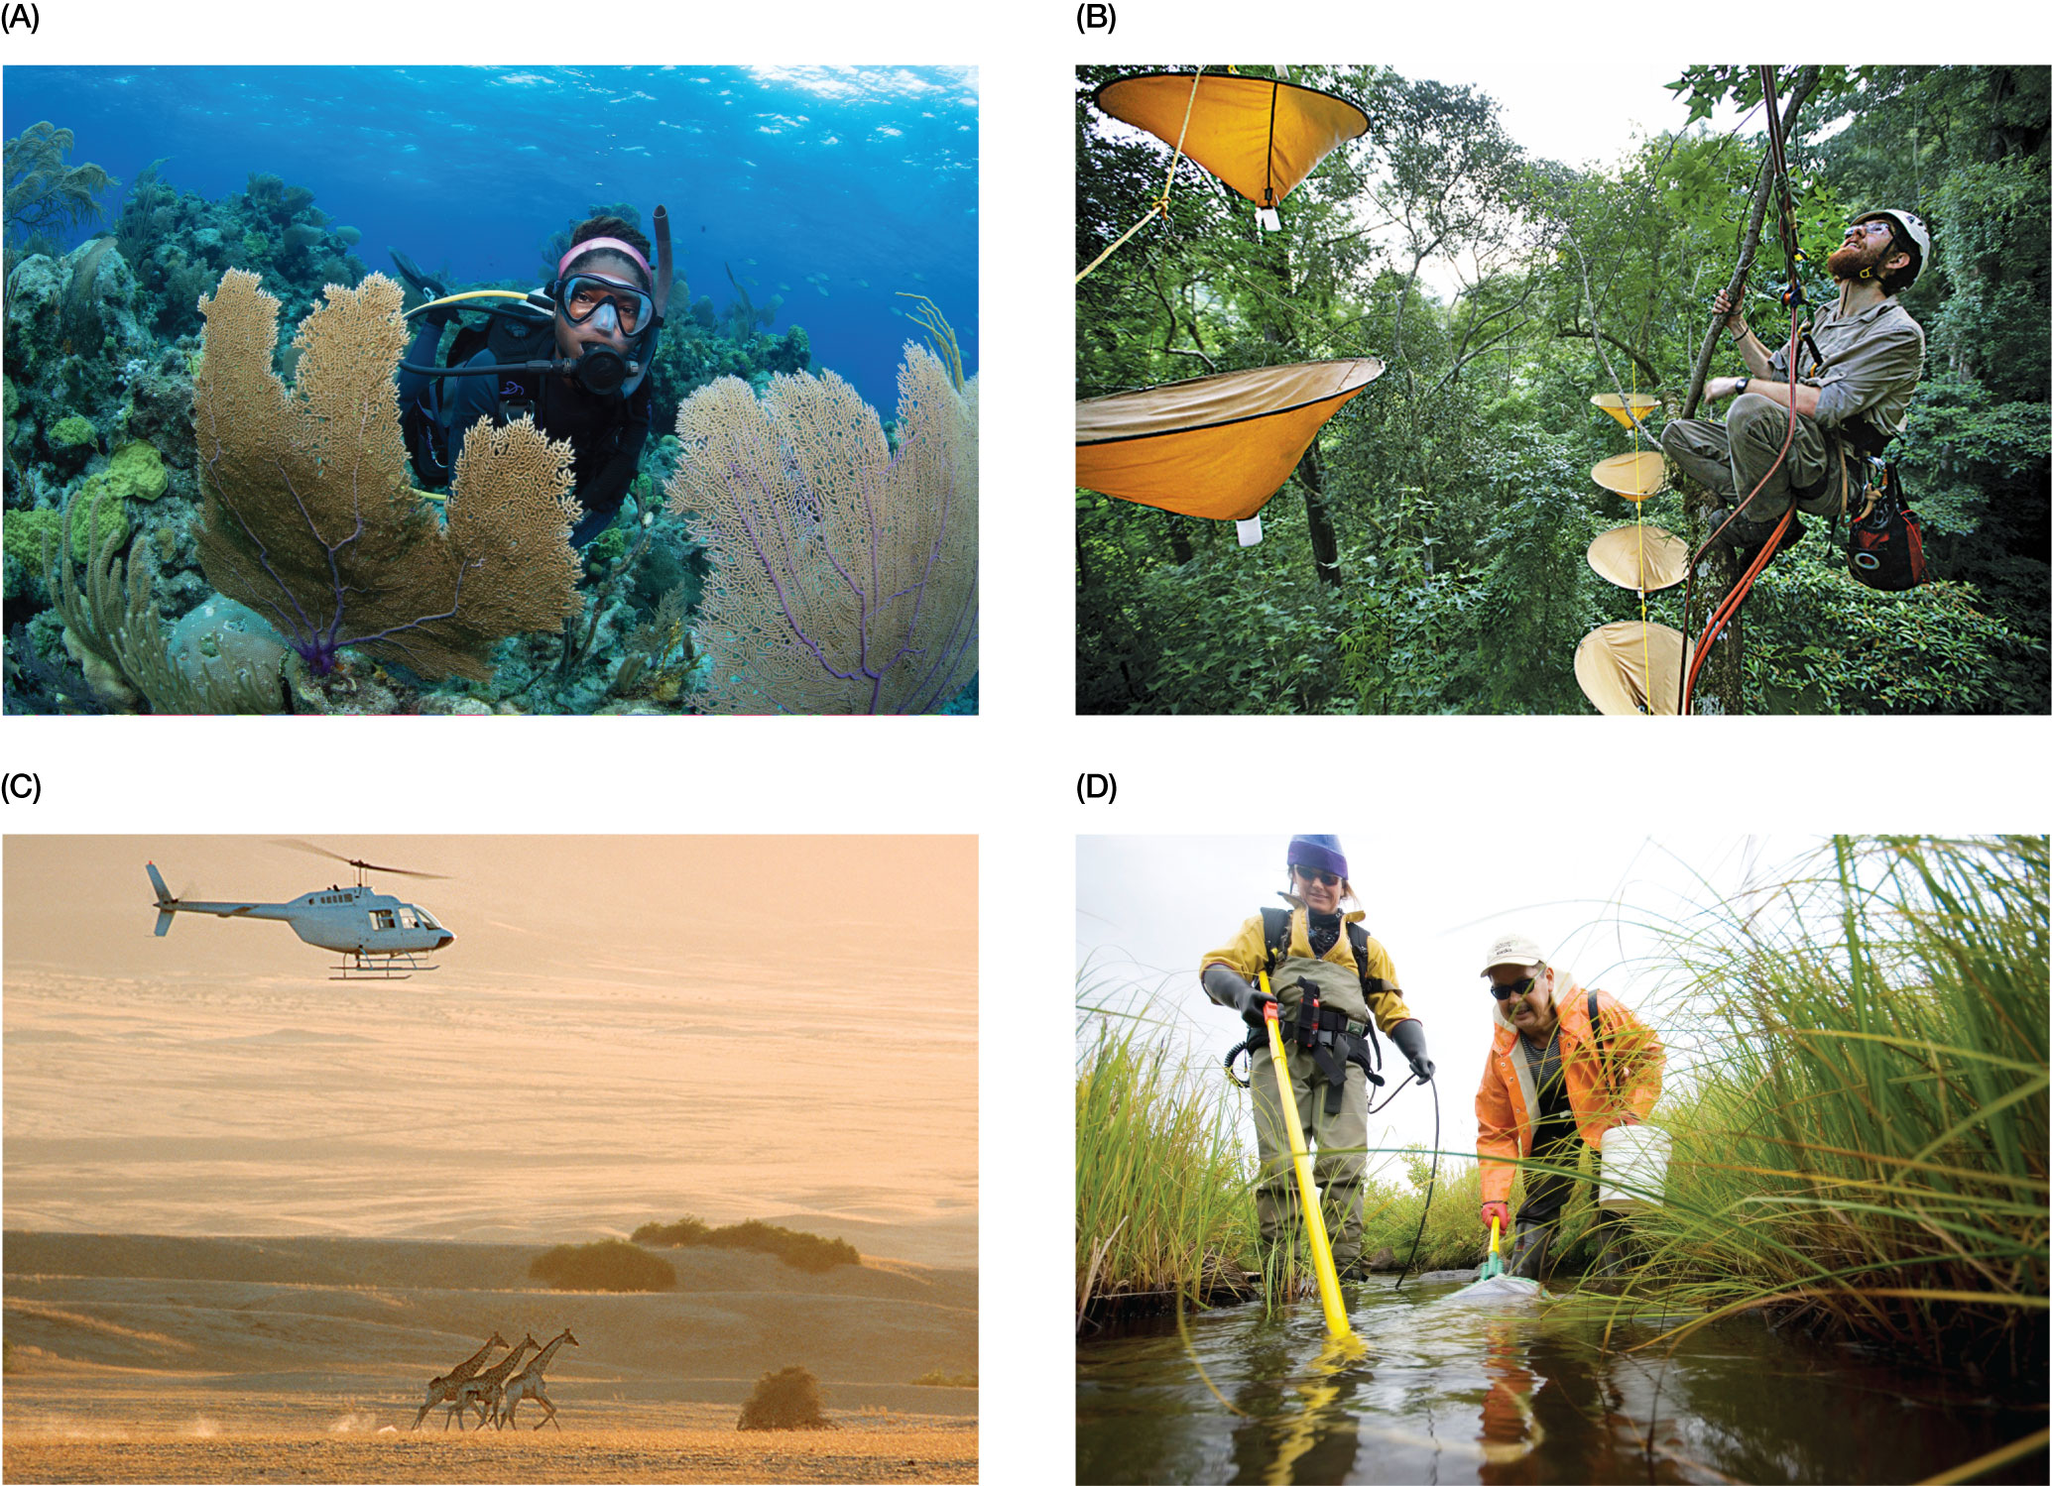
Figure 3.7 Biologists measuring biodiversity in different ecosystems.
Notes:
Figure 3.7 Biologists measuring biodiversity in different ecosystems. (A) A marine biologist counting coral species along a transect. (B) An entomologist tallying insect species in a tropical forest canopy. (C) Wildlife biologists performing surveys of animal abundance in African grasslands. (D) Ichthyologists electroshocking to count fish species in a stream.

Slide 11
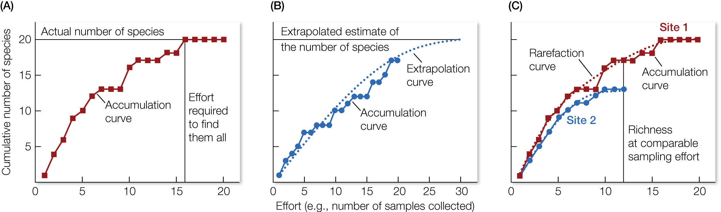
Figure 3.8 Types of sampling curves that conservation biologists use to estimate species richness at a site (or collection) and to compare biodiversity among sites (collections).
Notes:
Figure 3.8 Types of sampling curves that conservation biologists use to estimate species richness at a site (or collection) and to compare biodiversity among sites (collections). (A) shows a species accumulation curve. It quantifies the number of species found per sampling effort, which can be expressed in several ways, such as the number of samples collected and analyzed, the amount of time spent sampling, or the number of individuals identified. The accumulation curve is used to show when sampling is complete and all species have been identified. When sampling is incomplete, an extrapolation curve, shown in (B), can be fit to data from an Accumulation curve to estimate how many species there might be. Several advanced techniques have been developed to estimate the asymptotic richness of a collection that has been undersampled.18 (C) shows how to compare species richness at two sites that have received different sampling efforts. Site 1 would be expected to have more species based simply on the fact that it has been sampled more heavily. However, to determine whether site 1 truly has more diversity, we can “rarify” the accumulation curve by randomly selecting the same number of samples used to measure richness in the less sampled site (site 2). The resulting rarefaction curve can be used to compare species richness at the same level of sampling effort.

Slide 12
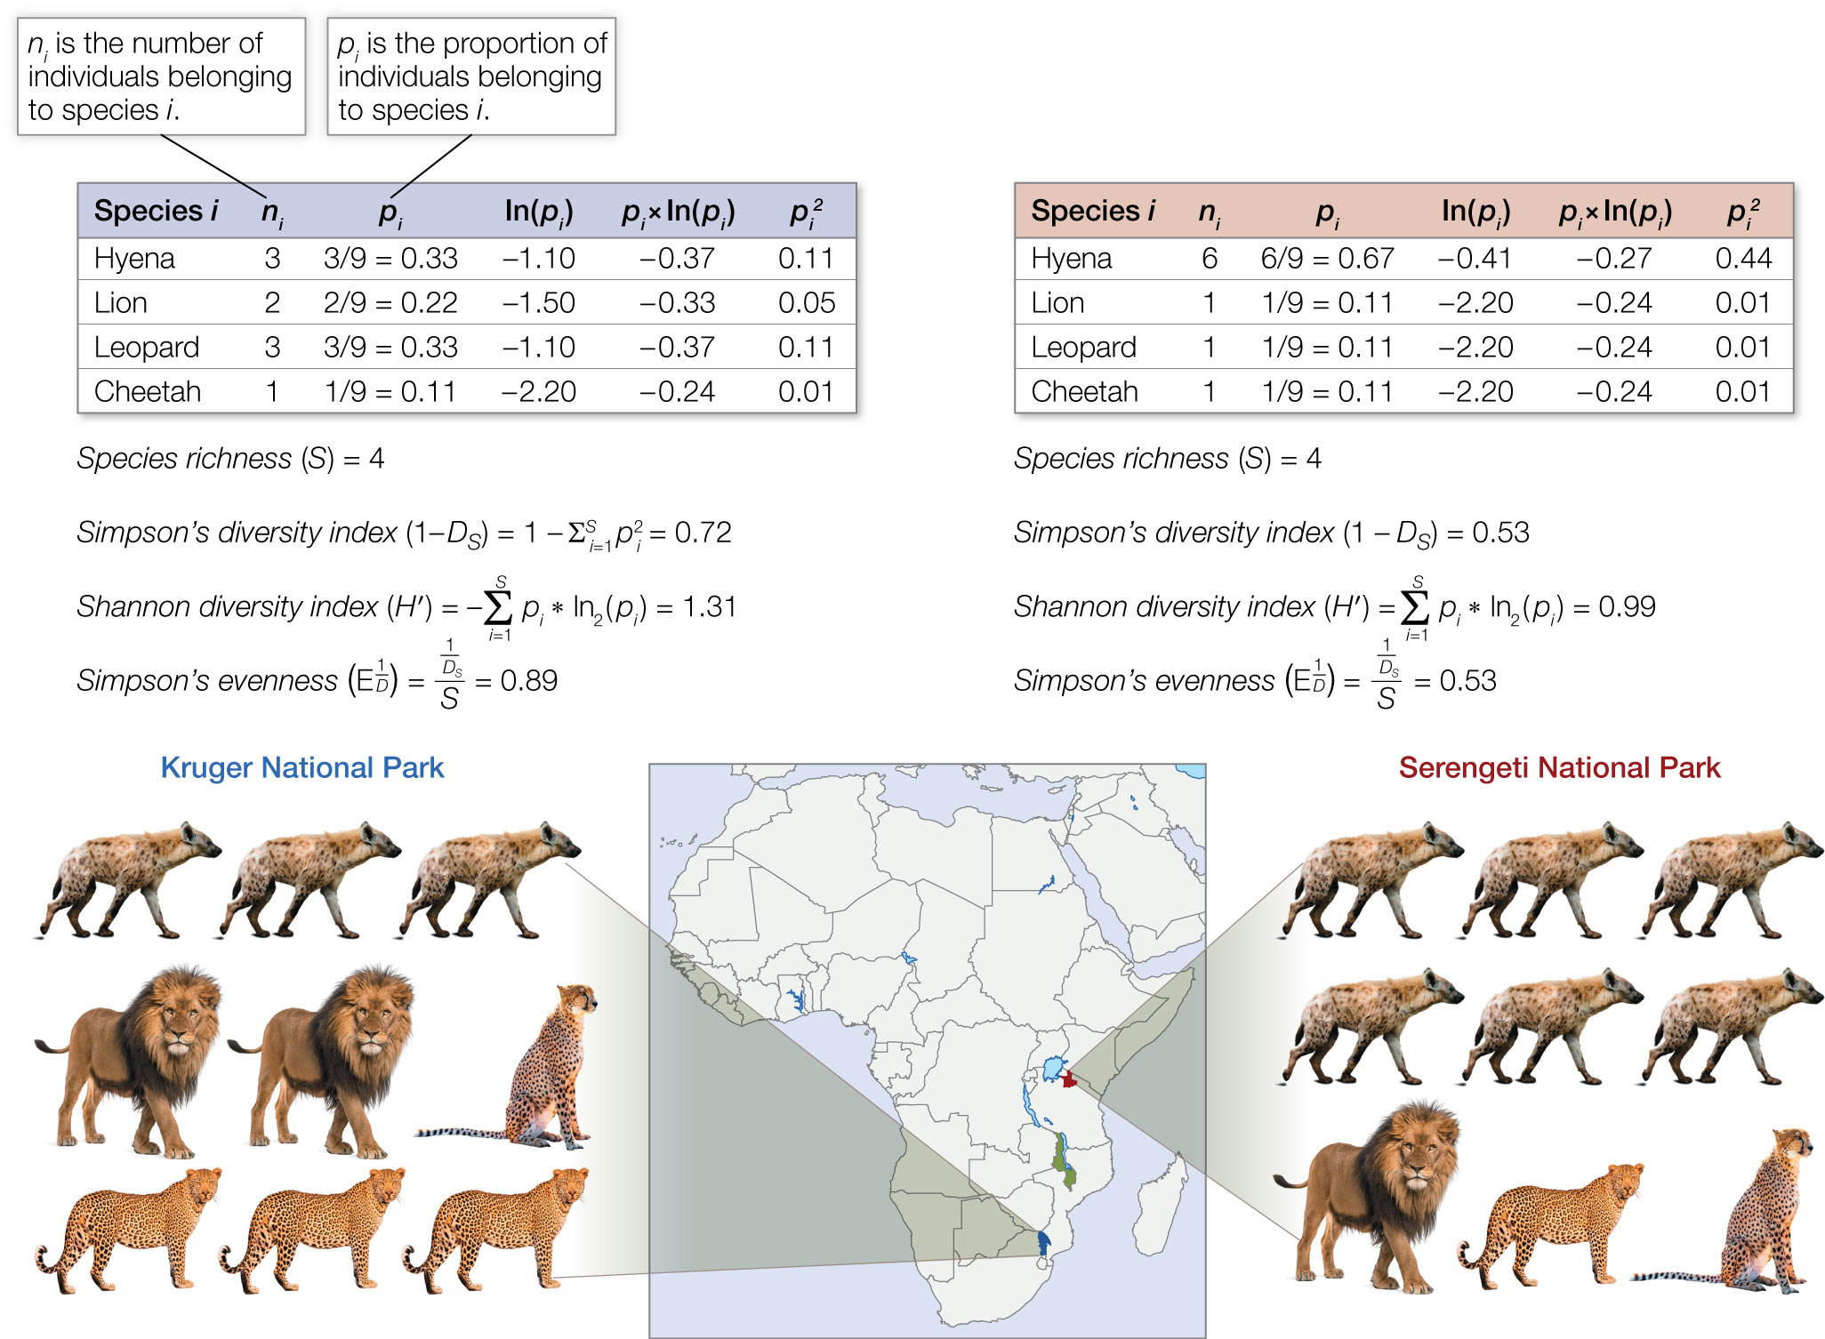
Figure 3.9 Measures of species diversity. This example compares species diversity for a hypothetical group of predators in Kruger and Serengeti National Parks in Africa.
Notes:
Figure 3.9 Measures of species diversity. This example compares species diversity for a hypothetical group of predators in Kruger and Serengeti National Parks in Africa. After the predators are surveyed visually (by helicopter or on the ground), both parks are found to have four predator species, and thus they have equal species richness. However, Serengeti National Park (right) is dominated mostly by hyenas, whereas abundances among predator species at Kruger National Park (left) are more evenly distributed. Diversity metrics that consider species evenness in addition to richness can be used to represent the higher diversity of species at Kruger National Park.

Slide 13
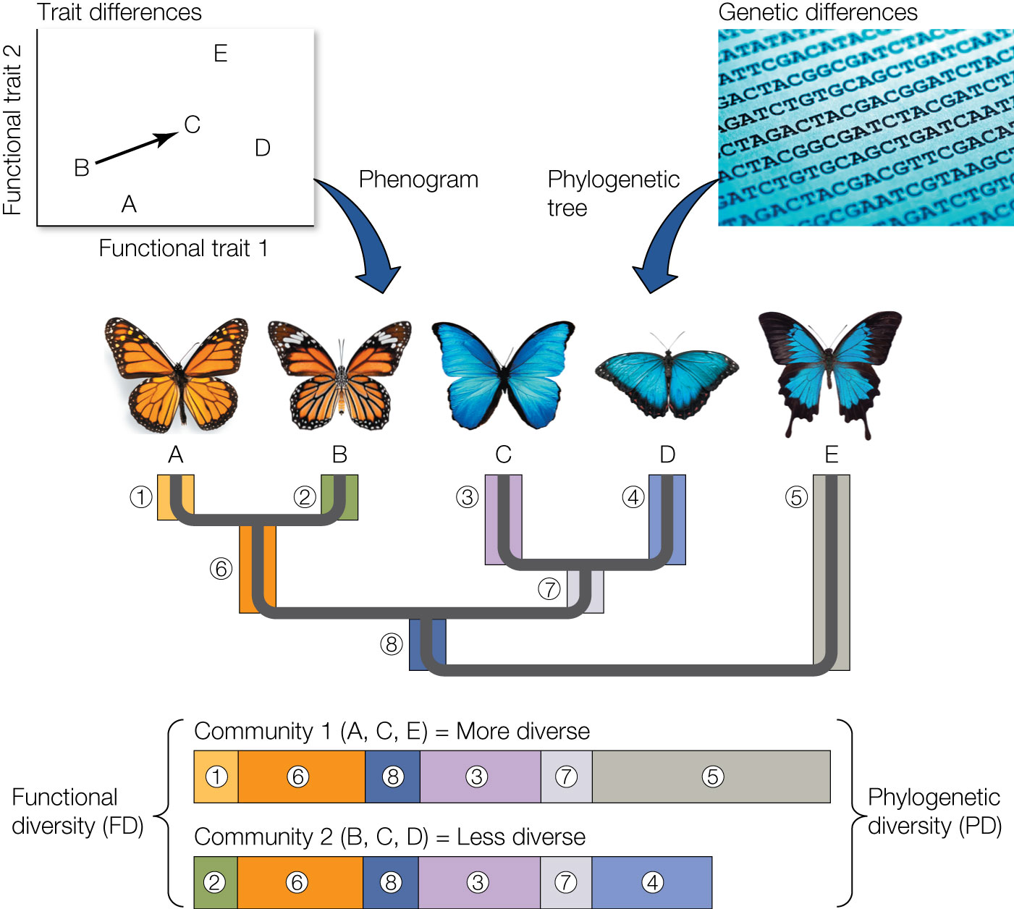
Figure 3.10 Measures of functional and phylogenetic diversity.
Notes:
Figure 3.10 Measures of functional and phylogenetic diversity. Functional diversity among species is measured with the aid of a phenogram, which is constructed from measures of species similarity/dissimilarity in functional traits. After measuring multiple traits of interest on a set of species, one calculates the distance separating species in an n-dimensional matrix. This is shown in the upper left panel as the Euclidian distance separating butterfly species B and C for measures of just two functional traits. The distances that separate species are then used to make a tree (i.e., phenogram) that depicts relationships among species based on their overall similarity in traits. One can sum up the branch lengths of the phenogram to get a measure of functional diversity among species (greater branch lengths = higher functional diversity). A similar approach can be taken when characterizing the phylogenetic diversity of species; however, the tree is called a phylogenetic tree, and we use genetic differences among species (e.g., the number of base pairs that differ) as the measure of similarity or dissimilarity. Summing branch lengths that separate species gives a measure of phylogenetic diversity, which is the amount of genetic differentiation between any set of species that has resulted since their divergence from a common ancestor.

Slide 14
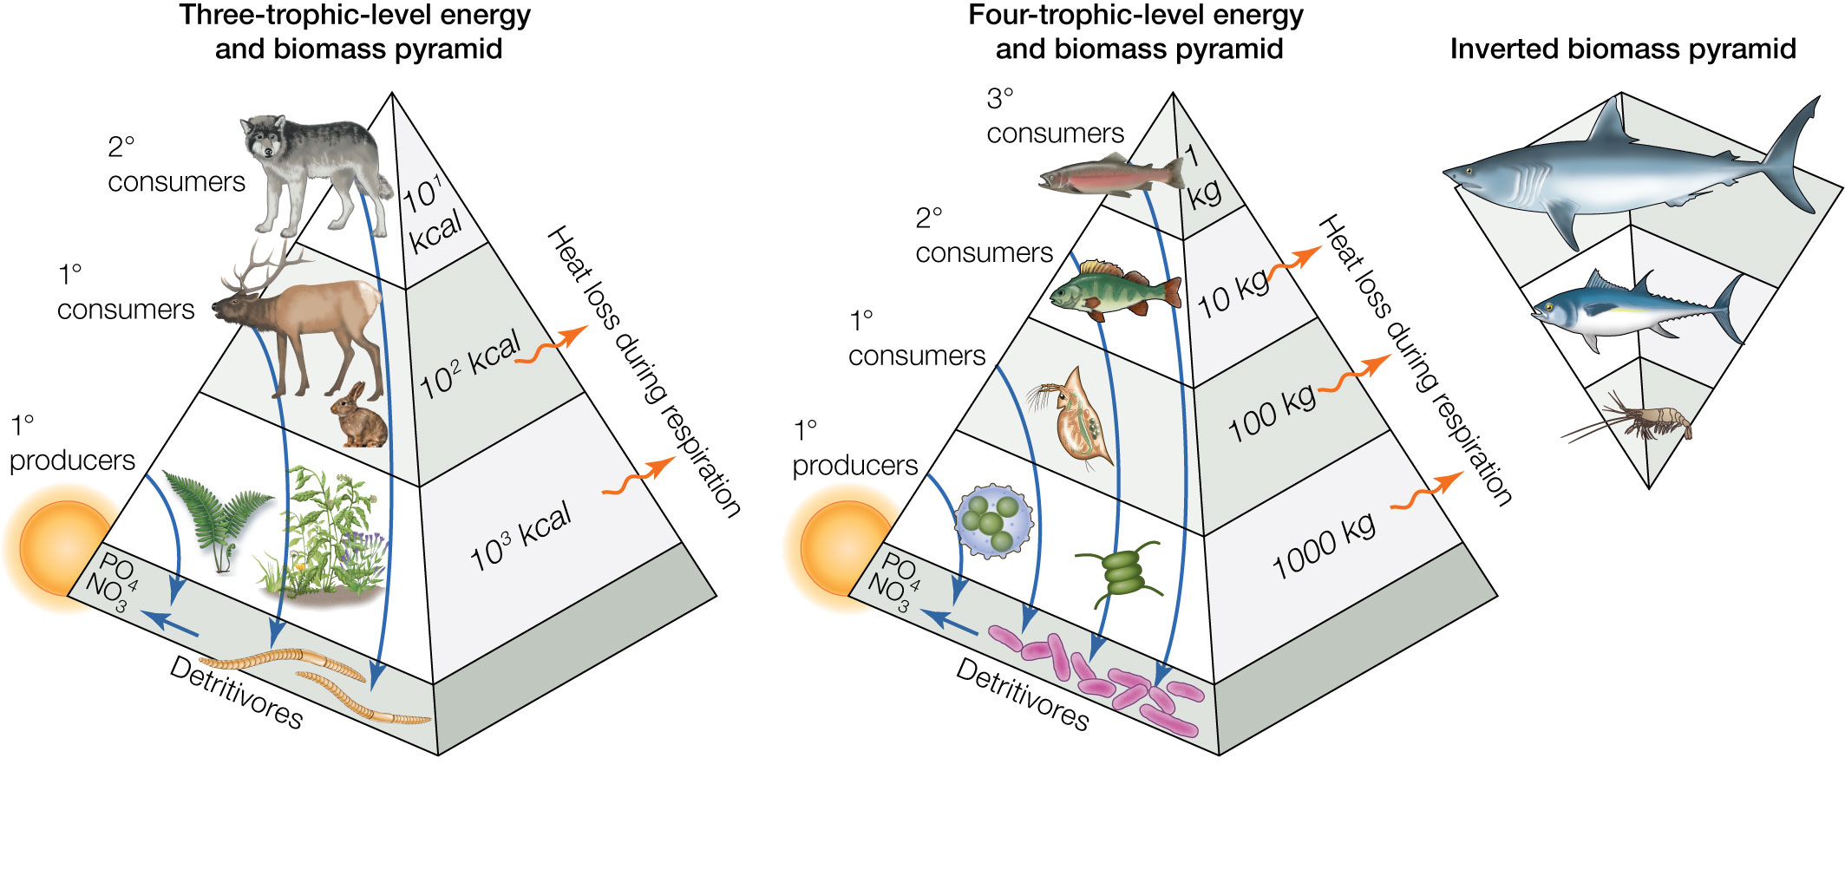
Figure 3.11 Examples of trophic pyramids that describe the amount of energy and biomass at each trophic level of a community.
Notes:
Figure 3.11 Examples of trophic pyramids that describe the amount of energy and biomass at each trophic level of a community. While energy always decreases at higher trophic levels because of heat loss during respiration, and while biomass usually decreases at higher trophic levels, it is possible to find inverted biomass pyramids in some ecosystems where the basal trophic levels that support the food web are short-lived and turn over quickly.

Slide 15
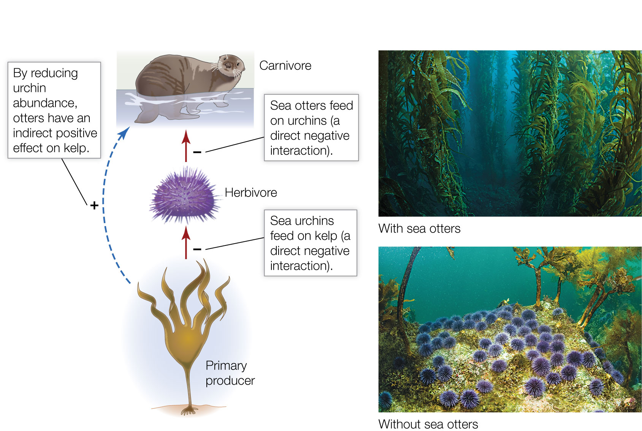
Figure 3.12 Example of a trophic cascade. As sea otters eat herbivorous sea urchins, kelp forests flourish. But when otters disappear because of overhunting or predation, urchins eat the stipes of the kelp, which results in urchin barrens.
Notes:
Figure 3.12 Example of a trophic cascade. As sea otters eat herbivorous sea urchins, kelp forests flourish. But when otters disappear because of overhunting or predation, urchins eat the stipes of the kelp, which results in urchin barrens.

Slide 16
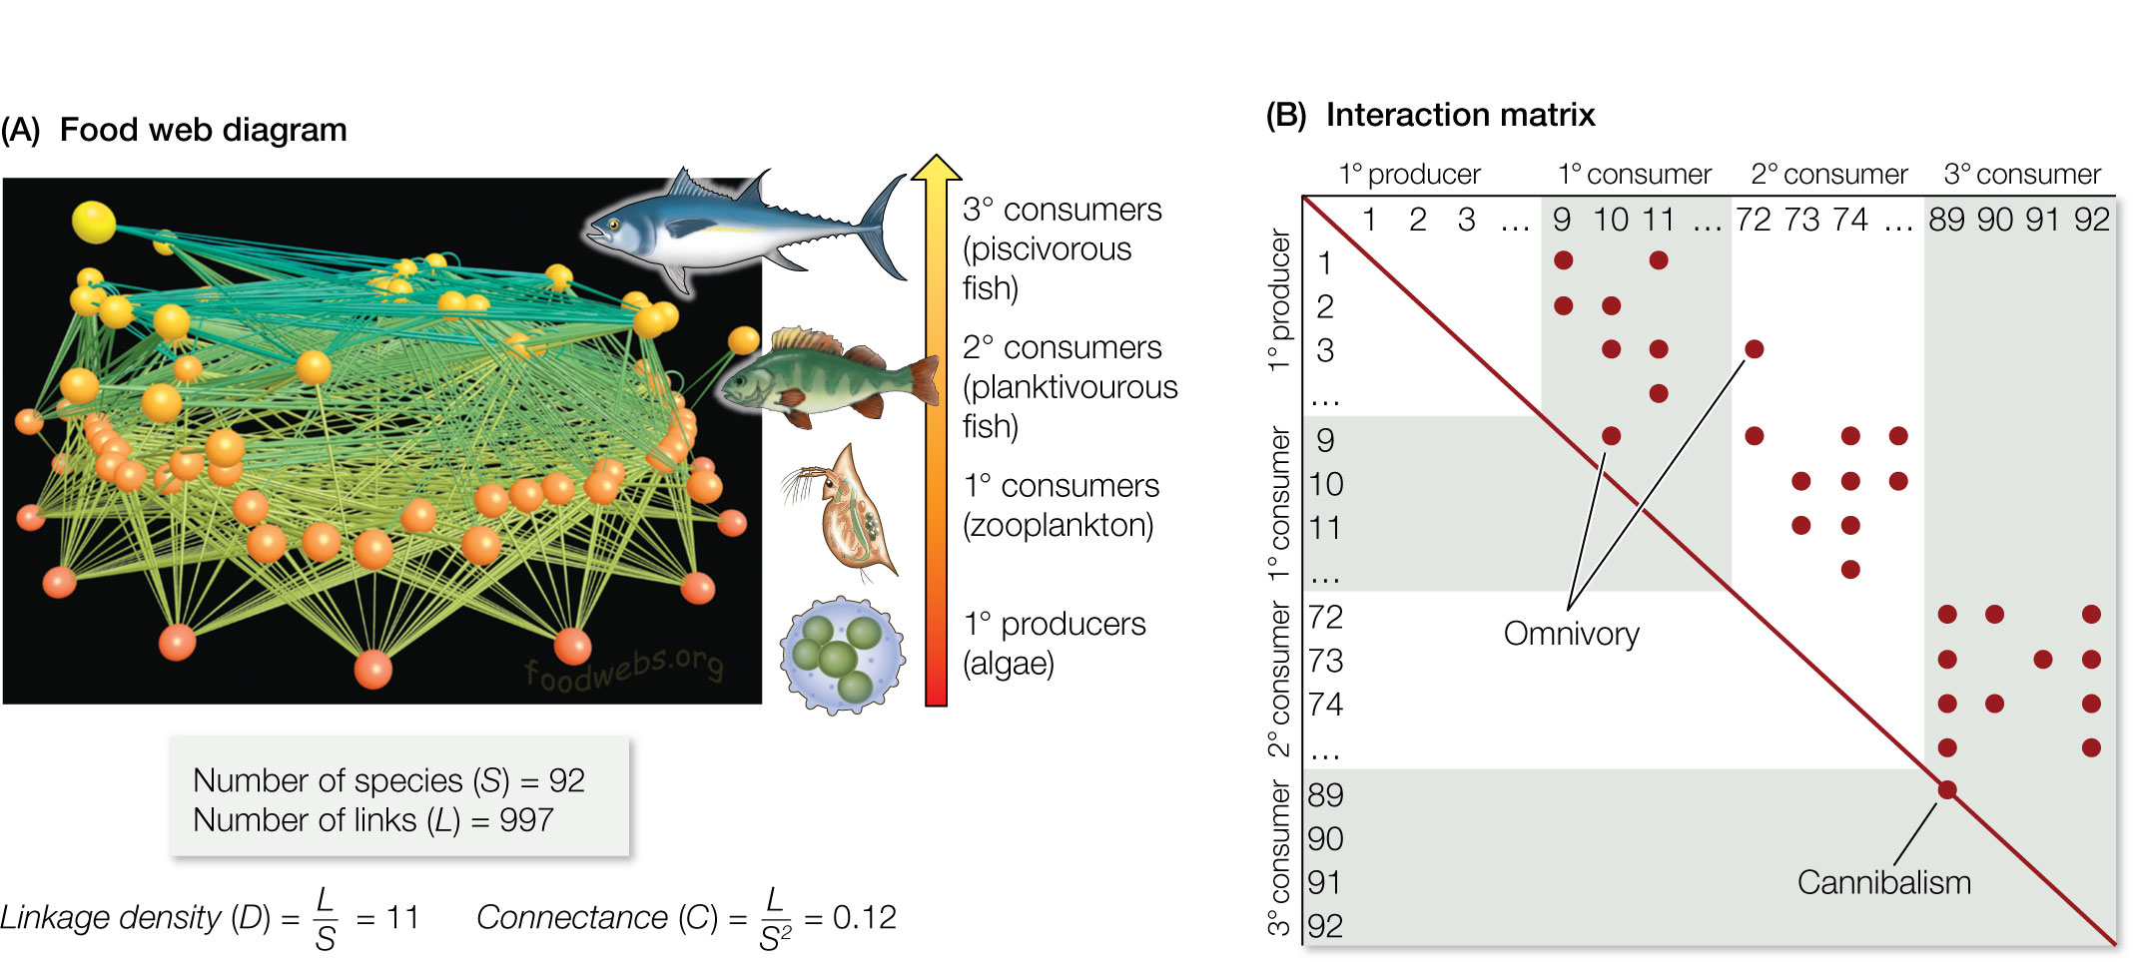
Figure 3.13 Measures of food web complexity. This example is for a hypothetical freshwater lake food web that contains 92 species spanning four trophic levels (1° producers to 3° consumers).
Notes:
Figure 3.13 Measures of food web complexity. This example is for a hypothetical freshwater lake food web that contains 92 species spanning four trophic levels (1° producers to 3° consumers). (A) The food web can be expressed as a diagram that shows feeding links between species and among trophic levels. (B) The food web can also be described by an interaction matrix showing the presence of a link among species in the community (a dot in the matrix). The food web diagram and matrix can be used to identify species with a disproportionately large number of links (such as omnivores and others that feed at multiple trophic levels). They can also be used to calculate the linkage density and connectance of species in the food web.

Slide 17
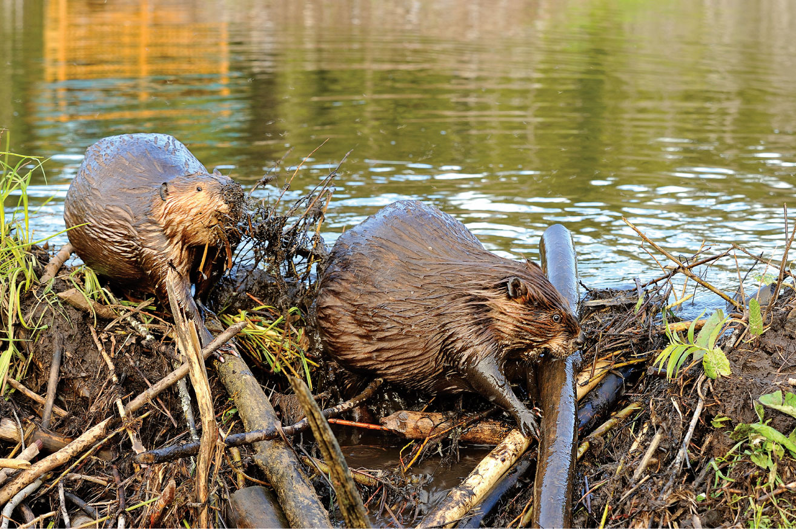
17
Notes:
Dam building by beavers creates diverse pond ecosystems that store water, reduce the probability of flooding, and increase ground water recharge.

Slide 18
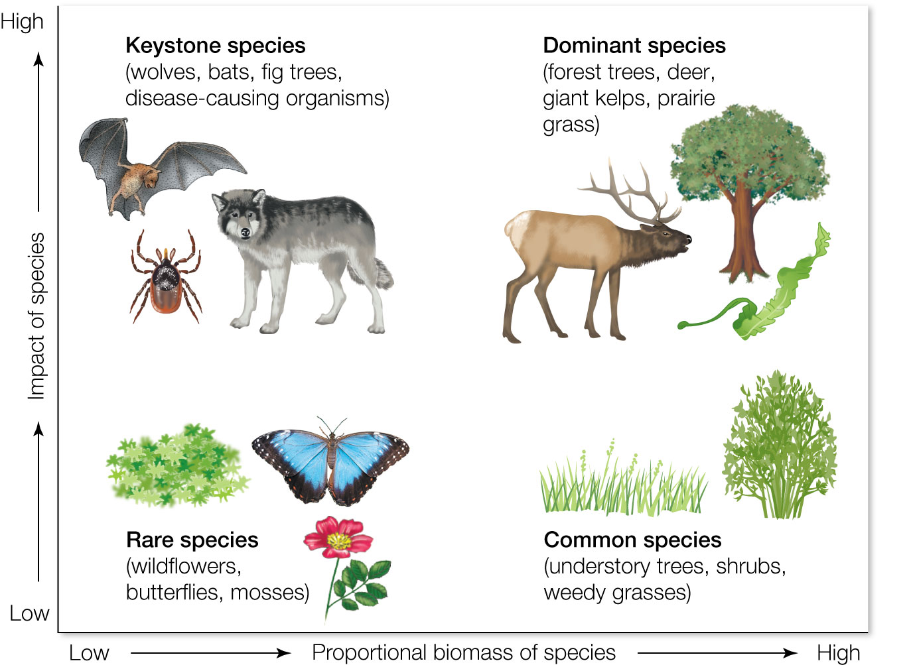
Figure 3.14 Keystone species determine the ability of large numbers of other species to persist within a biological community.
Notes:
Figure 3.14 Keystone species determine the ability of large numbers of other species to persist within a biological community. Although keystone species make up only a small percentage of the total biomass, a community’s composition would change radically if one of them were to disappear. Rare species have minimal biomass and seldom have significant impact on the community. Dominant species constitute a large percentage of the biomass and affect many other species in proportion to this large biomass. Some species, however, have a relatively low impact on the community organization despite being both common and heavy in biomass.

Slide 19
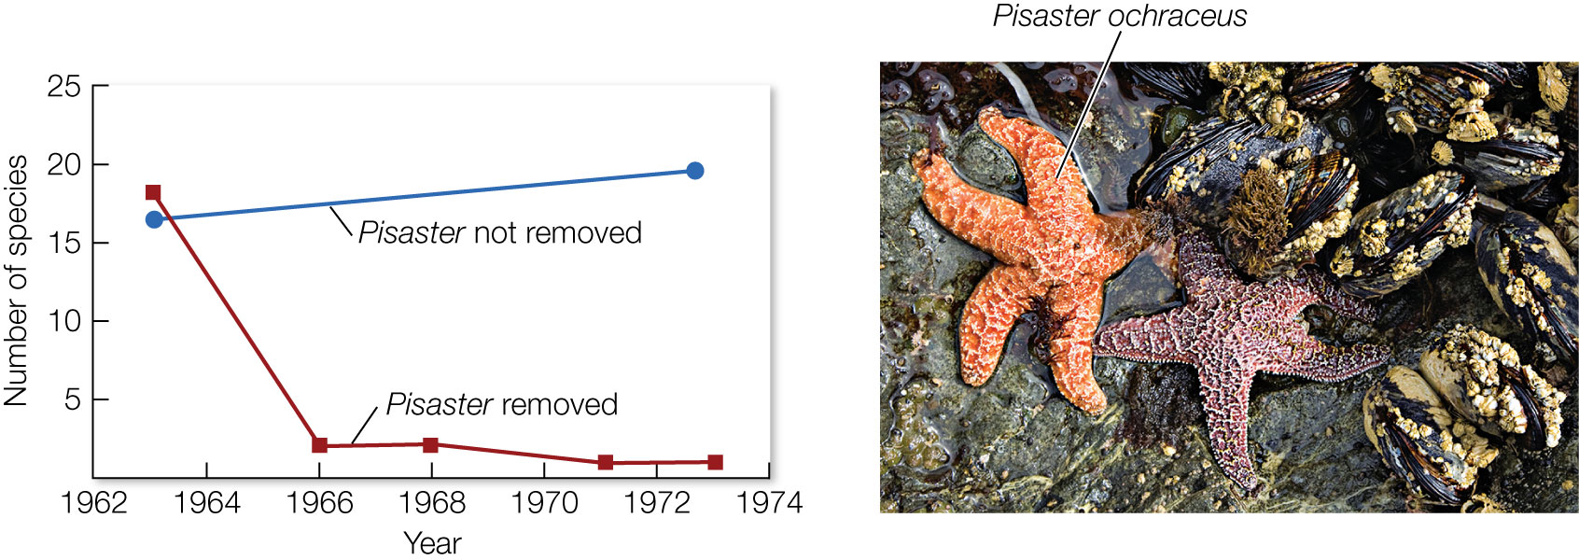
Figure 3.15 When ochre sea stars (Pisaster ochraceus) are present, competition among mollusk species is reduced, and many species can persist in the same habitat.
Notes:
Figure 3.15 When ochre sea stars (Pisaster ochraceus) are present, competition among mollusk species is reduced, and many species can persist in the same habitat. When P. ochraceus is experimentally removed, mollusks increase in abundance, and competition eventually eliminates most of the species.

Slide 20
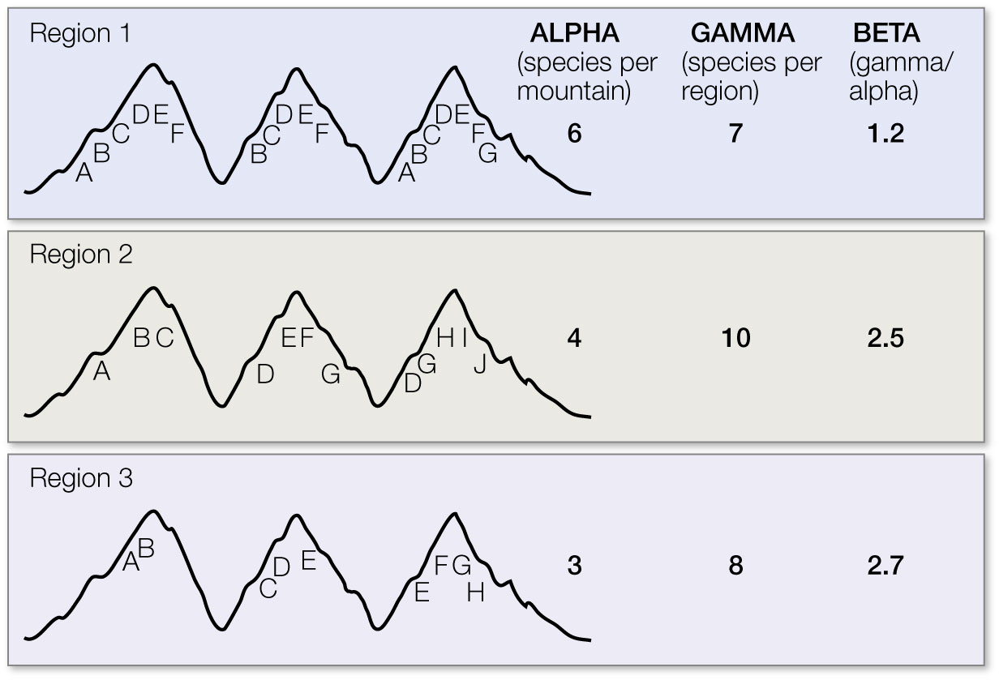
20
Notes:
Biodiversity indexes for three regions, each consisting of three separate mountains. Each letter represents a population of a species; some species are found on only one mountain, while other species are found on two or three mountains. Alpha, gamma, and beta diversity values are shown for each region. If funds were available to protect only one mountain range, region 2 should be selected because it has the greatest gamma (total) diversity. However, if only one mountain could be protected, a mountain in region 1 should be selected because these mountains have the highest alpha (local) diversity, that is, the greatest average number of species per mountain. Each mountain in region 3 has a more distinct assemblage of species than the mountains in the other two regions, as shown by the higher beta diversity. If region 3 were selected for protection, the relative priority of the individual mountains should then be judged based on the relative rarity of the assemblages.

